Slide 1
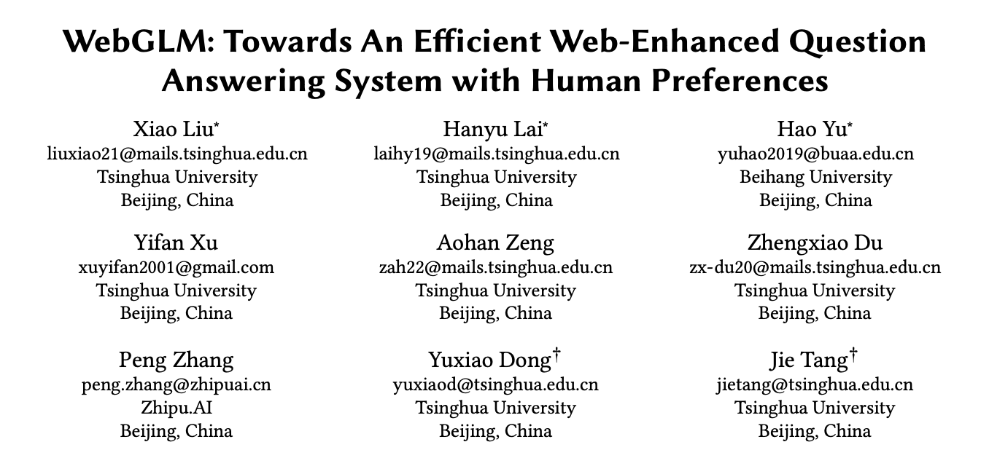
Paper Reading Session (Jennifer Zhu, March 4, 2024)
From KDD 2023 https://arxiv.org/pdf/2306.07906.pdf

Slide 2
Agenda
Challenges in the context of large models
The combination of knowledge and large models
WebGLM: an practical example of knowledge-enhanced large models

Slide 3
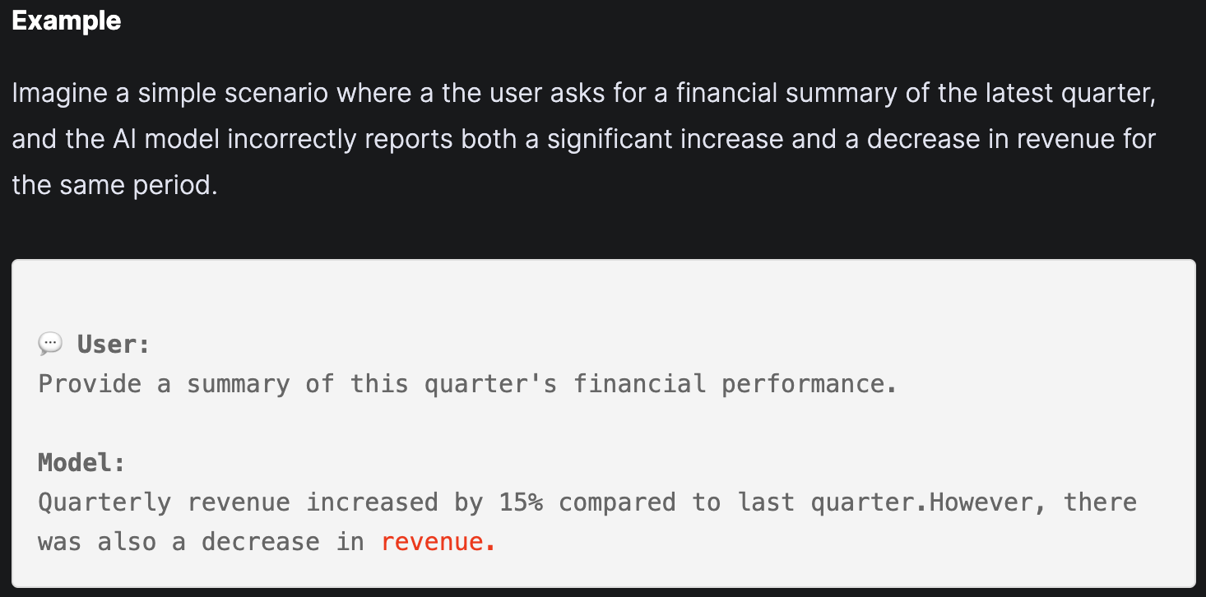
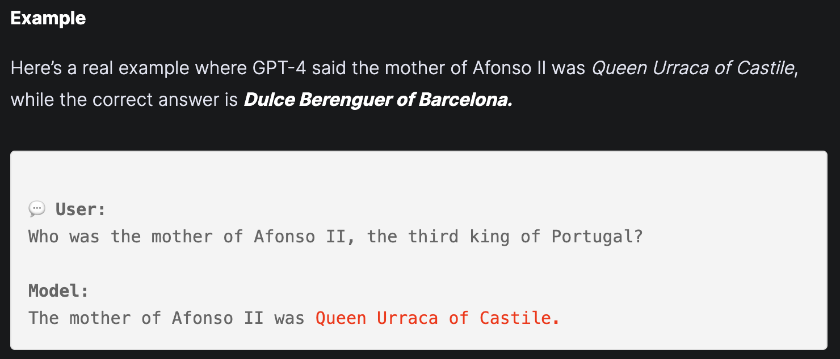
1. Challenges in the context of large models
Fact-Conflicting Hallucination
Context-Conflicting Hallucination
https://www.vellum.ai/blog/llm-hallucination-types-with-examples

Slide 4
1. Challenges in the context of large models
Prone to hallucinations
The knowledge stored in parameters acquired during the pre-training phase is difficult to update and verify, leading to hallucinations.
Poor stability of results
It is possible to make predictions using "surface clues" that are only relevant to the task label, resulting in poor stability of the results.
There is a bias
Large models have special preferences for certain types of labels, and relying on preferences to make predictions will lead to performance losses.

Slide 5
1. Challenges in the context of large models
Reasons
In fact, large models are better at memorizing facts than at summarizing them. This is because:
Large models treat all data equally during the training process and do not emphasize specific important parts.
Large models do not go through the cycle of observation → induction → deduction → correction.
Solutions
Data screening and optimization
Introducing external knowledge to enhance model induction and deduction capabilities.
Add interactive learning and correction mechanisms.

Slide 6
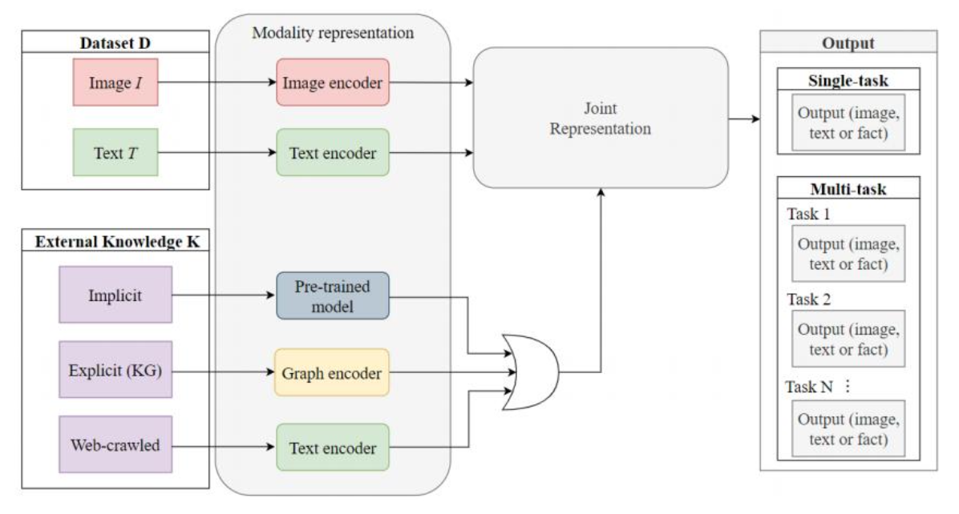
2. The combination of knowledge and large models
Model architectures
https://arxiv.org/abs/2211.12328

Slide 7
2. The combination of knowledge and large models
Knowledge-augmented large language model category
External knowledge: This refers to knowledge obtained from external knowledge sources (such as knowledge graphs), which can explicitly provide missing information and unlock new capabilities of large models and multi-modal large models. External knowledge can be further broken down into:
Factual knowledge: This refers to objective facts about entities, attributes, relationships, events, etc., which are usually stored in structured knowledge graphs.
Common sense knowledge: This refers to general and implicit knowledge about the world, which is usually not easy to obtain directly from text or images, but requires reasoning or logical inference.
Language knowledge: This refers to knowledge about the grammar, semantics, rhetoric, etc. of language, usually from online texts or language resources.
Internal knowledge: This refers to the knowledge that large models and multi-modal large models automatically extract from single or multi-modal data and does not rely on external knowledge sources. Internal knowledge can be further broken down into:
Implicit knowledge: This refers to the knowledge stored in the weights of the neural network, which is not easily understood or interpreted by humans and is usually obtained through pre-training or adversarial training.
Explicit knowledge: This refers to knowledge expressed in interpretable forms (such as diagrams, tables, trees, etc.), which can help humans understand or verify the behavior of the model, and is usually obtained through visualization or analysis.
Notes:
Knowledge-augmented large language model category
u External knowledge: This refers to knowledge obtained from external knowledge sources (such as knowledge graphs), which can explicitly provide missing information and unlock new capabilities of large models and multi-modal large models. External knowledge can be further broken down into:
l Factual knowledge: This refers to objective facts about entities, attributes, relationships, events, etc., which are usually stored in structured knowledge graphs.
l Common sense knowledge: This refers to general and implicit knowledge about the world, which is usually not easy to obtain directly from text or images, but requires reasoning or logical inference. l Language knowledge: This refers to knowledge about the grammar, semantics, rhetoric, etc. of language, usually from online texts or language resources.
u Internal knowledge: This refers to the knowledge that large models and multi-modal large models automatically extract from single or multi-modal data and does not rely on external knowledge sources. Internal knowledge can be further broken down into:
l Implicit knowledge: This refers to the knowledge stored in the weights of the neural network, which is not easily understood or interpreted by humans and is usually obtained through pre-training or adversarial training.
l Explicit knowledge: This refers to knowledge expressed in interpretable forms (such as diagrams, tables, trees, etc.), which can help humans understand or verify the behavior of the model, and is usually obtained through visualization or analysis.

Slide 8
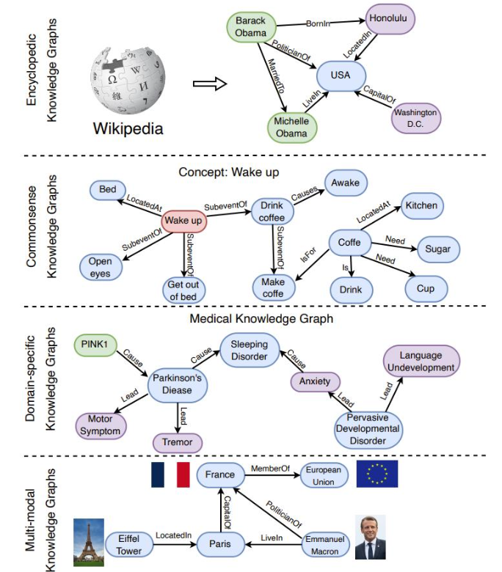
2. The combination of knowledge and large models
Take knowledge graph as an example
Encyclopedic Knowledge Graph (Encyclopedic KG)
Encyclopedia-type knowledge graphs are the most common KG and are constructed by integrating information from a variety of broad sources, including experts, encyclopedias, and databases. Wikidata is one of the most widely used encyclopedia-type knowledge graphs, incorporating various knowledge extracted from Wikipedia articles. Other typical encyclopedia-type knowledge graphs, such as Freebase, Dbpedia and YAGO, are also derived from Wikipedia.
Commonsense KG
Common sense knowledge graphs represent everyday concepts and their relationships as knowledge. ConceptNet contains a wide range of common sense concepts and relationships that help computers understand the meaning of words. ATOMIC and ASER focus on causal connections between events and can be used for common sense reasoning.
Domain-specific knowledge graph (Domain-specific KG)
Domain-specific knowledge graphs are usually used to represent knowledge in specific fields (such as medicine, biology, finance, etc.). Compared with encyclopedic knowledge graphs, domain-specific knowledge graphs are usually smaller but more accurate and reliable. For example, UMLS is a domain-specific knowledge graph in the medical field, containing biomedical concepts and their relationships. In addition, there are some domain-specific knowledge graphs in other fields, such as finance, geology, biology, chemistry, etc.
Multi-modal knowledge graph (Multi-modal KG)
Different from traditional knowledge graphs that only contain text information, multimodal knowledge graphs use multiple modalities (such as pictures, sounds, and videos) to represent facts and can be used for various multimodal tasks, such as image-text matching, visual question answering systems and recommendations.
https://arxiv.org/html/2306.08302v3

Slide 9
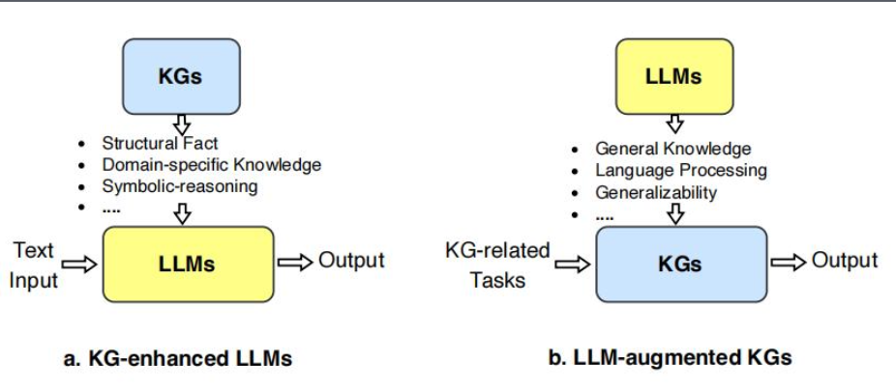
2. The combination of knowledge and large models
Take knowledge graph as an example
Use knowledge graphs to enhance large language models, then knowledge graphs can not only be integrated into the pre-training and inference stages of LLM to provide external knowledge, but can also be used to analyze LLM to provide interpretability.
Using large language models to enhance knowledge graphs, LLM has been used in a variety of knowledge graph-related applications, such as knowledge graph embedding, knowledge graph completion, knowledge graph construction, knowledge graph to text generation, and knowledge graph question and answer. LLM can improve the performance of knowledge graphs and facilitate their applications.
https://arxiv.org/pdf/2306.08302.pdf

Slide 10
2. The combination of knowledge and large models
Challenges and research directions
Challenge: Integrate knowledge graphs and large models to maintain real-time updates and accuracy of knowledge.
Research direction: Large model knowledge enhancement based on knowledge graph
Solution strategy: Develop a dynamic knowledge graph update mechanism to improve the interoperability between knowledge graphs and models
Paper: A Survey of Knowledge Enhanced Pre-Trained Language Models
Challenge: Efficiently and accurately retrieve relevant knowledge from massive data.
Research direction: retrieval-based knowledge enhancement
Solution strategy: Use advanced retrieval algorithms and indexing technology to improve retrieval speed and accuracy. Then use retrieval enhancement methods to overcome LLM’ limitations, such as illusions and limited knowledge. The idea behind the retrieval enhancement method is to reference external data when asking questions and provide it to the LLM to enhance its generation accuracy and the ability to provide relevant answers.
Paper: Few-shot Learning with Retrieval Augmented Language Models
Paper: REPLUG: Retrieval-Augmented Black-Box Language Models
Paper: YuLan-Chat: An Open-Source Bilingual Chatbot

Slide 11
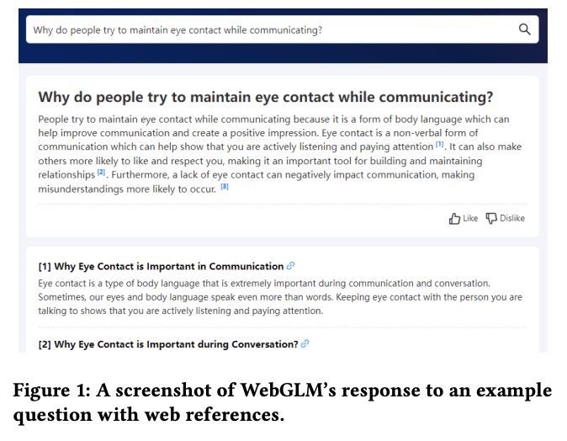
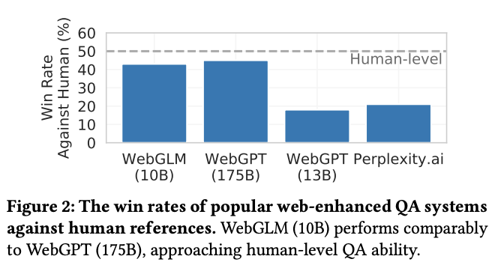
3. WebGLM: an practical example of knowledge-enhanced large models
Enhance pre-trained large language models:
The main goal of WebGLM (this paper) is to enhance pre-trained large language models (LLM) with web search and retrieval capabilities. This enhancement is intended to enable language models to more effectively
Process and answer web-based inquiries.
Solve the limitations of existing systems:
WebGLM aims to solve the limitations of existing systems such as WebGPT (openAI) and provide a more optimized and efficient network-enhanced question and answer solution.
https://arxiv.org/pdf/2306.07906.pdf

Slide 12
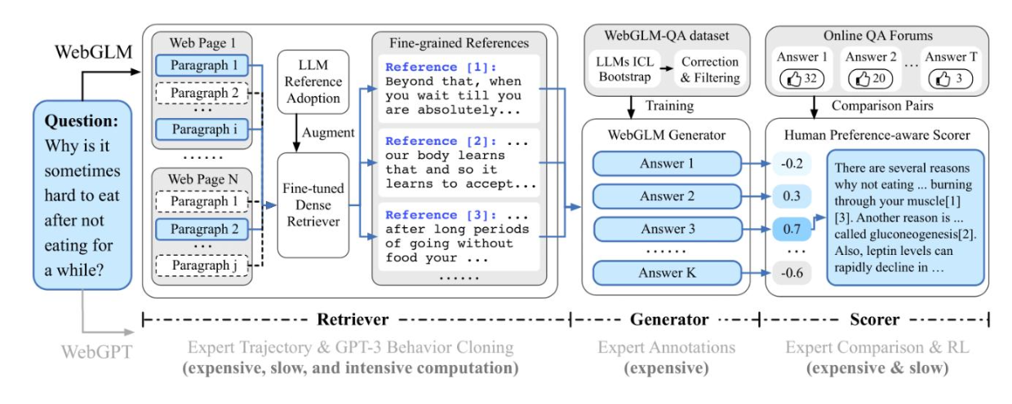
3. WebGLM: an practical example of knowledge-enhanced large models
LLM-retrieval
This component is responsible for understanding user queries and retrieving relevant information from the network. It utilizes the power of large language models (LLM) to parse queries and combines it with web search technology to find relevant web resources.
Generator
Once relevant information is retrieved, the self-service generator is responsible for extracting and synthesizing answers from this information. This process may involve analyzing the retrieved text, extracting key information, and combining this information to produce a coherent and accurate answer.
Scorer that considers human preferences
This component is used to evaluate the generated answers to ensure that they are not only accurate but also consistent with the user's preferences and expectations. This may involve analyzing historical user feedback, preferences, etc., to adjust answer generation.

Slide 13
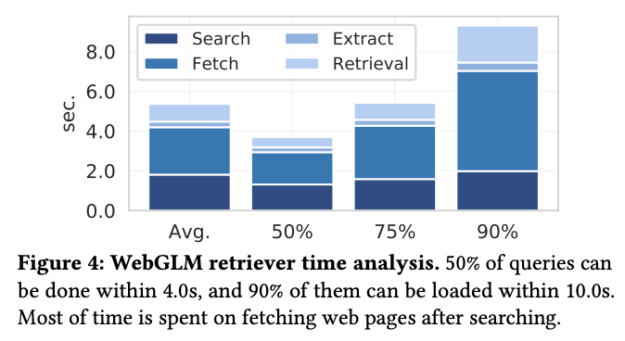
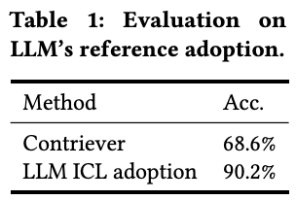
3. WebGLM: an practical example of knowledge-enhanced large models
Retriever

Slide 14
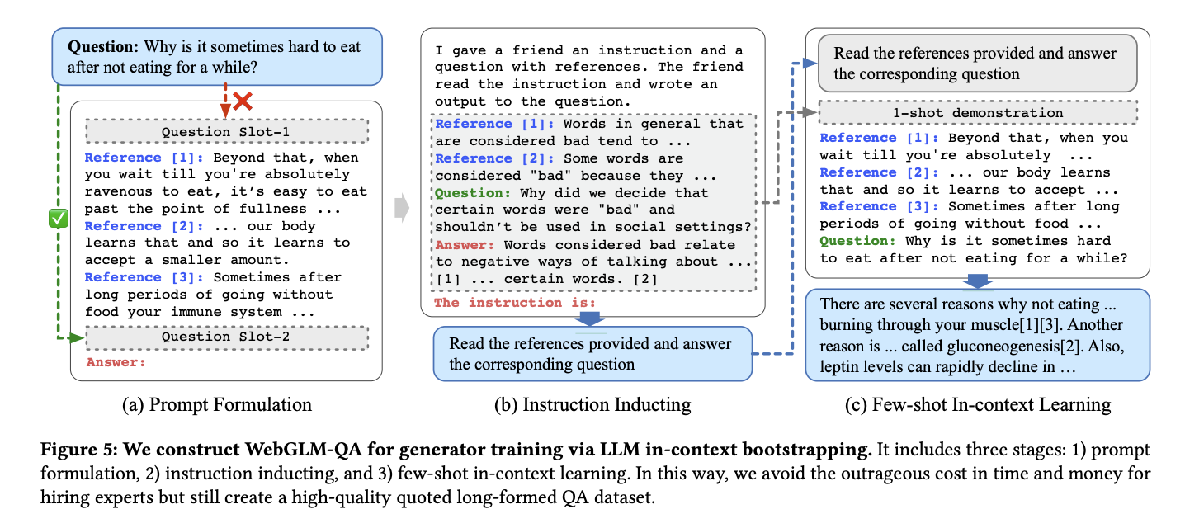
3. WebGLM: an practical example of knowledge-enhanced large models
generator training

Slide 15
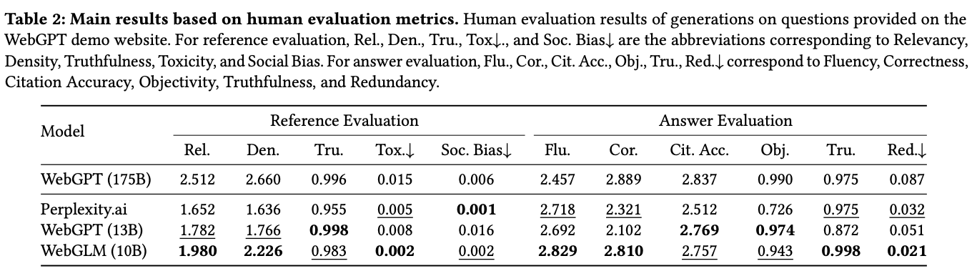
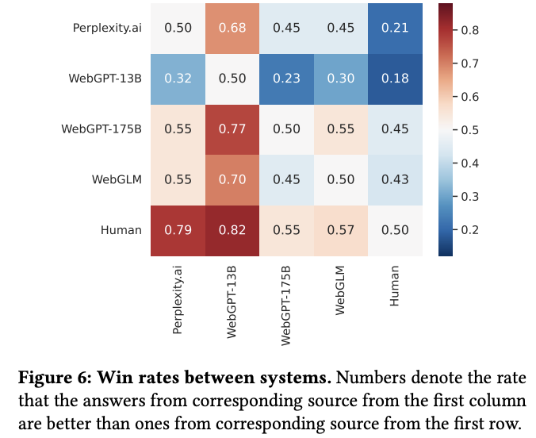
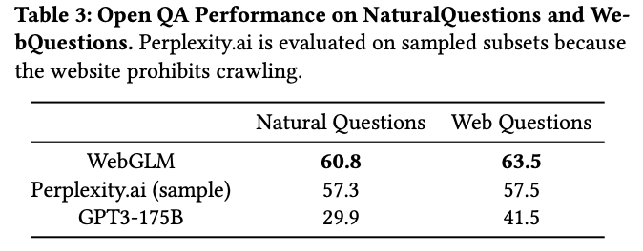
3. WebGLM: an practical example of knowledge-enhanced large models

Slide 16
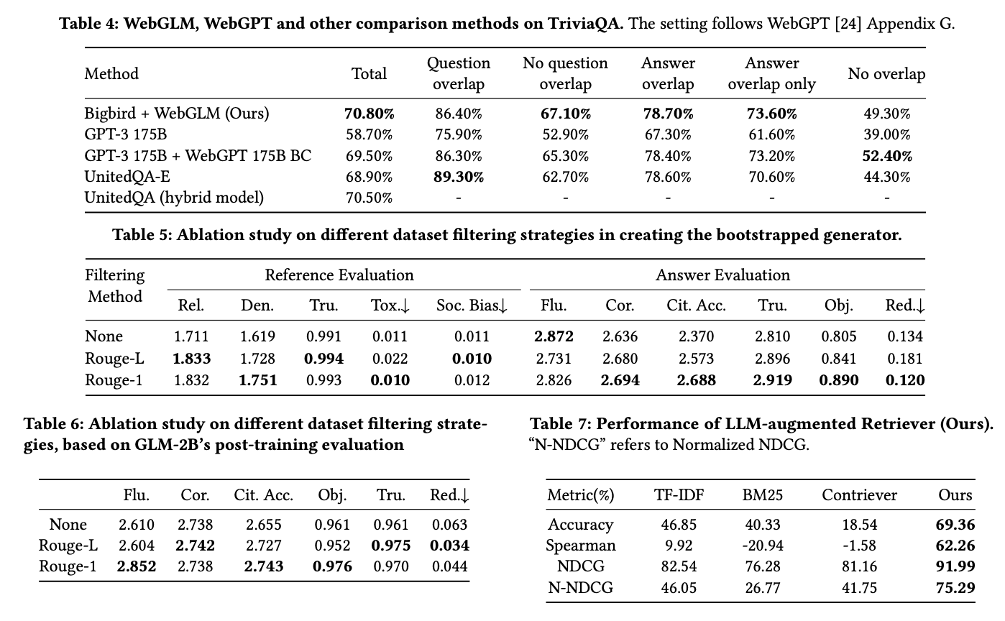
3. WebGLM: an practical example of knowledge-enhanced large models

Slide 17
3. WebGLM: an practical example of knowledge-enhanced large models
WebGLM summary
Here we take WebGLM (the architecture is still the chatglm architecture) as an example. They try an efficient and low-cost network-enhanced question and answer form, which combines network search and recall functions.
It can be integrated into large language models, which is very helpful for those who want to do research in vertical fields such as finance and education.
Code address: https://github.com/THUDM/WebGLM/tree/main
Related data sets: https://cloud.tsinghua.edu.cn/d/3927b67a834c475288e2/?p=%2F&mode=list
In this area, as a means of data enhancement, Internet search is faster than building a professional knowledge graph, but it is more noisy. I recommend that you package the retrieval module into a third-party package. Introducing it in the form of an interface is important for tasks with high data timeliness requirements.

